Slide 1

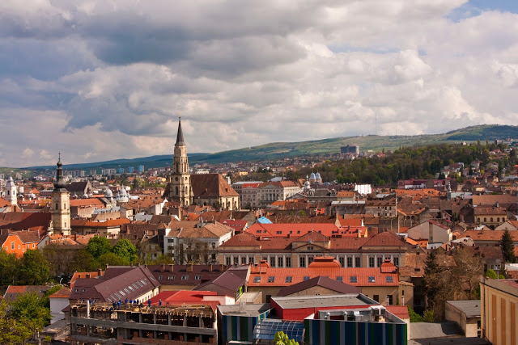
Smart Cities and Communities
Challenges and opportunities
Regio Days 2017
18 September 2017
Cluj-Napoca, Romania
Andreea Strachinescu
European Comission
Directorate General for Energy
Head Of Unit
New energy technologies, innovation and clean coal

Slide 2



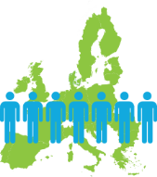
EU Challenges
Modernise our economy by bringing down greenhouse gas emissions while creating jobs and growth
ENERGY UNION
The EU as the world leader on renewable energy and placing energy efficiency first based on new technologies and industrial leadership
Ensure a socially fair transition where regions, cities and consumers play an active role
2

Slide 3
Cities – Drivers of energy and climate policy
2020 2030
20% less greenhouse gases
20% renewable Energy
20% Energy savings
40% less greenhouse gases
27% renewable Energy
27% Energy savings
Energy Union
3

Slide 4

ENERGY UNION STRATEGY
The 5 dimensions
The Energy Union aims at secure, sustainable, competitive, affordable energy.
Energy
Efficiency first
Energy security,
solidarity and trust
A fully integrated
energy market
Research,
Innovation and
Competitiveness to develop
technological leadership
Decarbonising
the economy
Integrated SET Plan, including Smart Cities and Communities

Slide 5

Stakeholders
Cities & Regions
Industry
Research
Associations
etc. …
Covenant of Mayors
Political commitments without EU funding
Smart Cities & Communities
EU actions
EU Initiatives
CIVITAS
Green Digital Charter
CONCERTO
SCC-EIP Market Place
Commitments Implementation without EU funding
Lighthouse Projects
Implementation & replication with EU funding
Smart City Information System
5

Slide 6

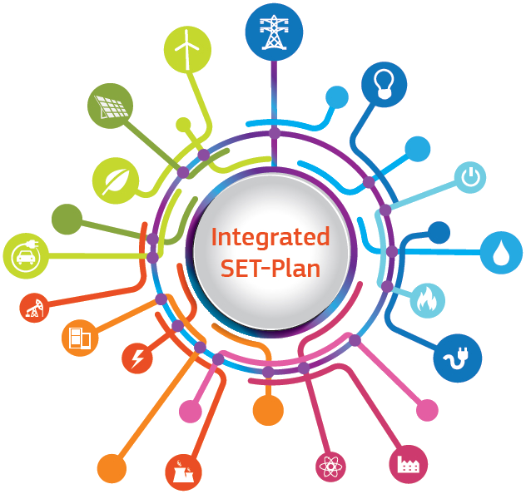


Three strands of action …
6
Notes:
Title will automatically show after 1 second, don't click!

Slide 7
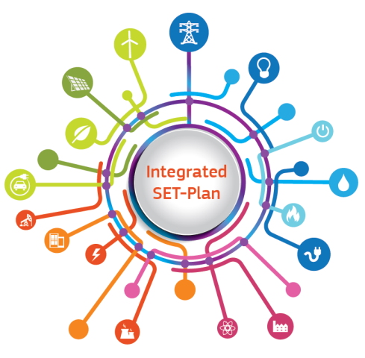
The
Strategic Energy Technology
(SET) Plan
7
Notes:
Title will automatically show after 1 second, don't click!

Slide 8

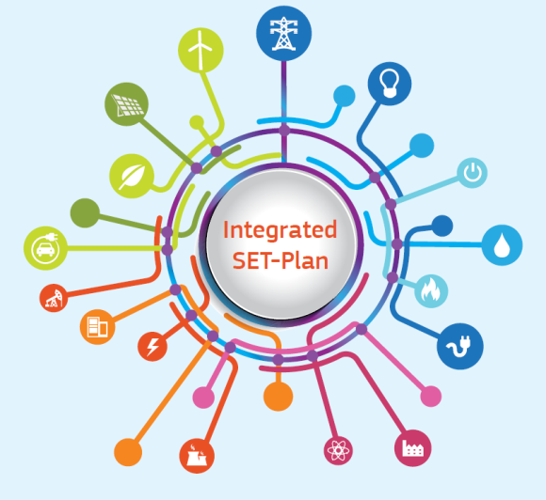
The Strategic Energy Technology (SET) Plan
Adopted in 2008
Set-up of European Industrial Initiatives for technologies
& Coordinates the research actions of EU and Member States
For technologies with market impact up to 2020 and beyond
Integrated SET Plan Communication (2015)
Technologies and innovation Platforms (industry and MSS) and Four core priorities (RES, consumers, energy efficiency, sustainable transport – in line with Energy Union) + CCS and nuclear
10 Key Actions

Slide 9
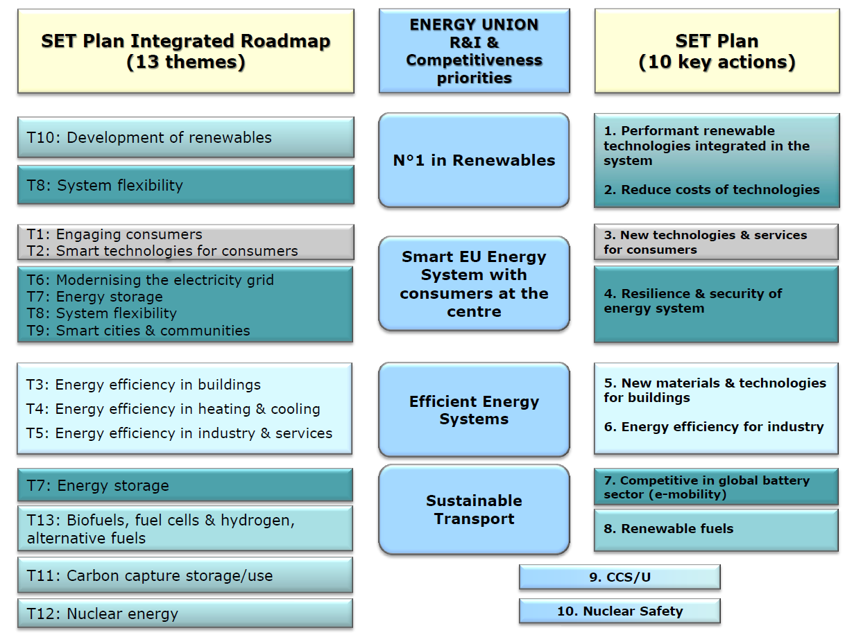
SET Plan structure
TEMPORARY WORKING GROUPS
Global leadership in Photovoltaics
Global leadership in solar thermal el.
Global leadership in offshore wind.
Global leadership in deep geothermal
Global leadership in ocean
Smart solutions for energy consumers
Smart cities and communities
Smart energy systems
5. New materials & technologies for buildings
6. Energy Efficience in Industry
New materials and tech. For EE solutions for Buildings
Cross cutting Heating and Cooling technologies for buildings
Energy Efficiency in Industry
Become competitive in the global battery sector
Strengthen market take-up of renewable fuels
''Renewing efforts to demonstrate (CCS)/CCU
Maintaining a high level of safety of nuclear reactors

Slide 10
SET plan Working Groups relevant to Smart Cities
Smart solutions for energy consumers
Main Targets focusing on:
Positive energy blocks
Reduction of low energy house cost
increased efficiency
of Heating/Cooling technologies
Increased flexibility of the energy system
Smart cities and communities
Smart energy systems
New materials and technologies
for EE solutions for Buildings
Cross cutting Heating and Cooling technologies for buildings

Slide 11


European Innovation Partnership On
Smart Cities and Communities
(EIP-SCC)
11

Slide 12

Smart Cities and Communities (EIP-SCC)
establishes strategic partnerships between industry and European cities for the development of the urban systems of tomorrow

Slide 13









The 6 Action Clusters
5100 partners,
370 commitments,
31 countries.
EIP
It is all about scale,
acceleration, impact,
common solutions,
integrated approaches
and collaboration.
13

Slide 14
Citizen focus
The 6 EIP-SCC
Action Clusters
Policy and regulations/ integrated planning
Sustainable districts and built environment
EIP
Business models, finance & procurement
Integrated infrastructures and processes
Sustainable urban mobility
14

Slide 15

Smart city ecosystems for replicable high impact solutions
General roadmap
Cluj-Napoca, Timisoara and Voluntari contributed to the commitments
Bankable
projects
Scaling up successful commitments
4000 partners
in 370 commitments
Strategic Implementation Plan
Gap
analysis
FUTURE
Fragmented Smart Cities market
PAST
Future
15

Slide 16

Towards a real market
Pilot projects
(3rd wave)
Check the EIP-SCC roadmap at https://goo.gl/atm2T6
Project design,
stakeholder engagement,
pilot project definitions
Lessons learned,
maturity reached,
replication &
further roll-out
Pilot projects
(2nd wave)
€ 1 billion
investment
by 2020
Pilot projects
(1st wave)
300 cities
engaged
by 2020
2017
2019
16

Slide 17

Why being involved?
Practical knowledge sharing
Capacity building
Partnering for EU or other projects
Bundling of demand enables easier access to all funding sources
Gaining visibility for your city, project, association, company, etc.
17

Slide 18



How to join?
Create a public profile at
https://eu-smartcities.eu/content/get-involved-our-initiatives
Join an existing commitment or an initiative.
Join an Action Cluster to provide your specific expertise on a certain issue.
18

Slide 19

€ 5.9 billion
For ENERGY
€ 80 billion
In total
THE FRAMEWORK PROGRAMME FOR RESEARCH AND INNOVATION
19

Slide 20

What EU does through the energy research programme
Horizon 2020 is the biggest EU Research and Innovation programme
Nearly €80 billion of funding available over 7 years (2014 to 2020)
Promises more breakthroughs, discoveries and world-firsts by taking great ideas from the lab to the market
Notes:
The European Innovation Partnership on Smart Cities and Communities is an initiative supported by the European Commission bringing together cities, industry, SMEs, banks, research and other smart city actors.

Slide 21
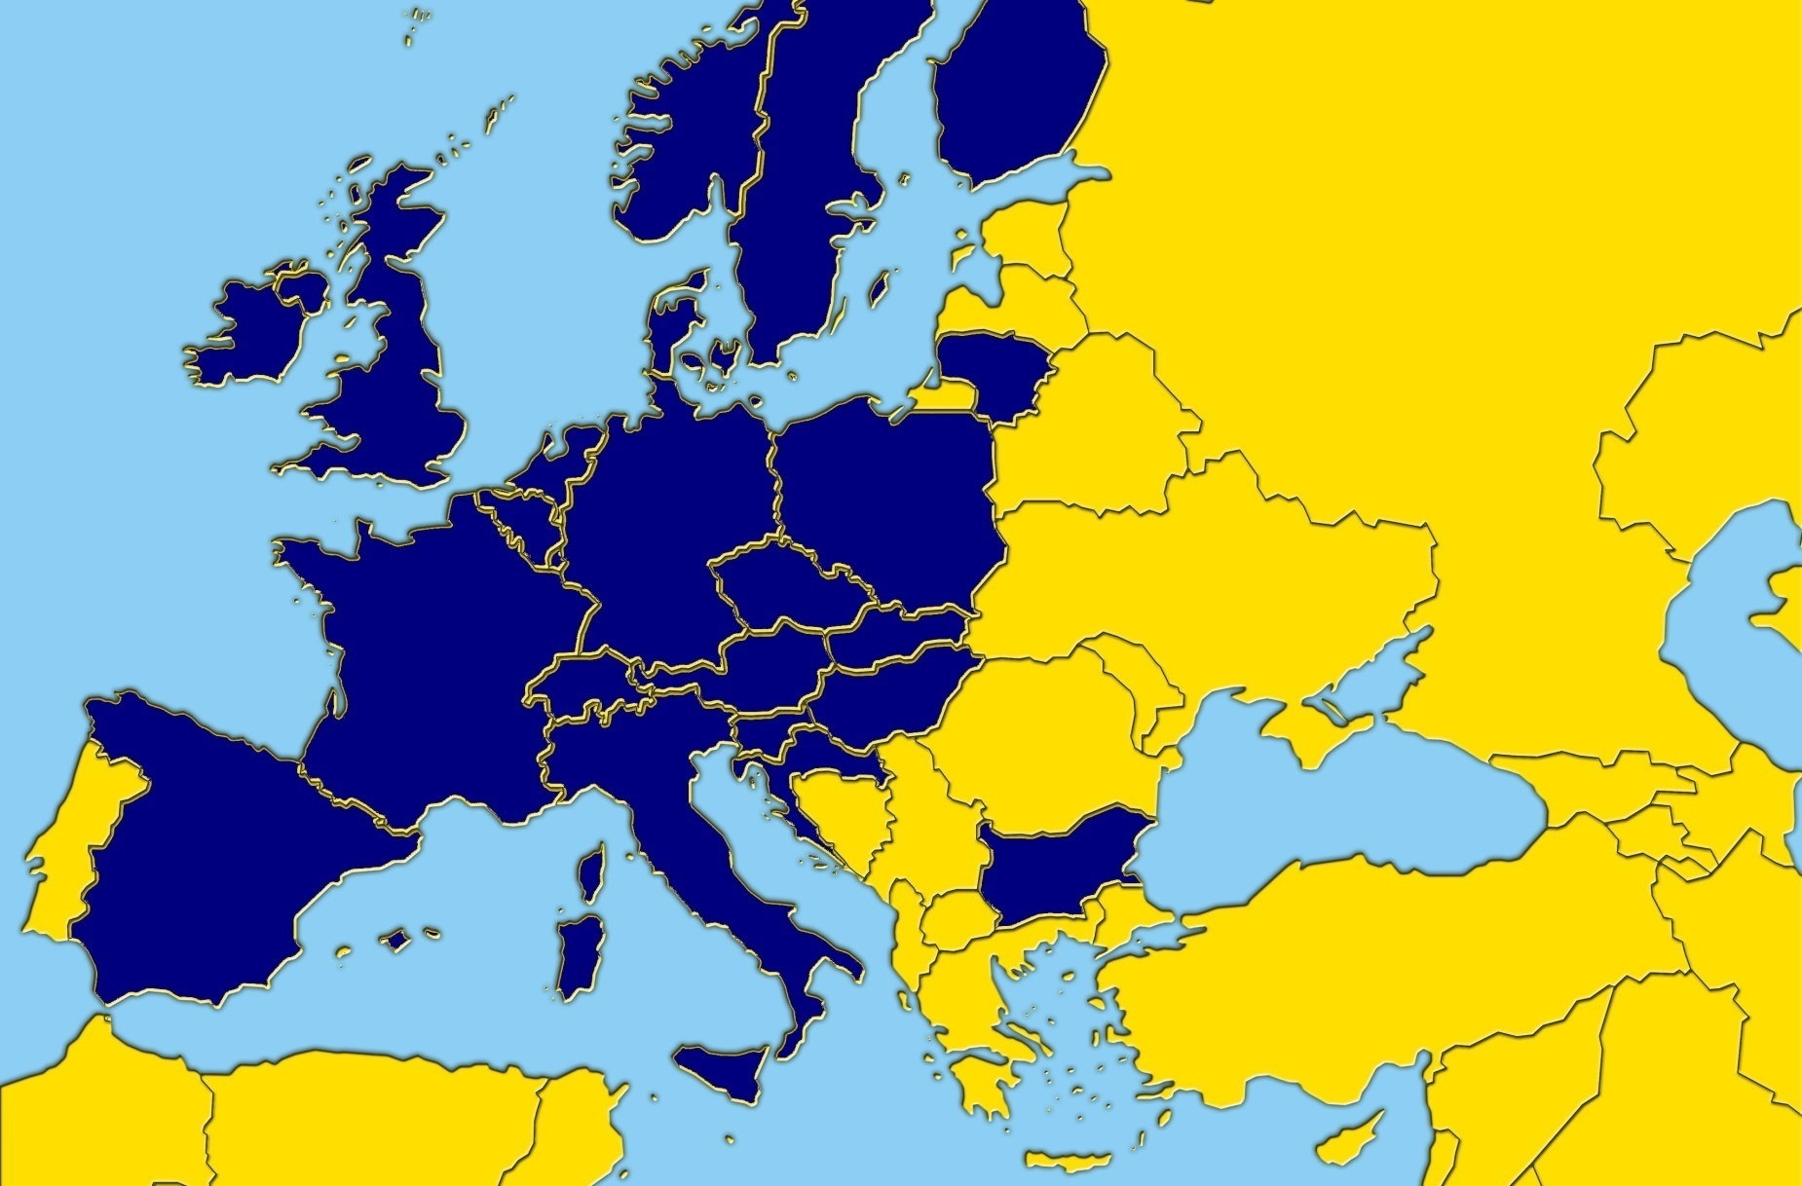
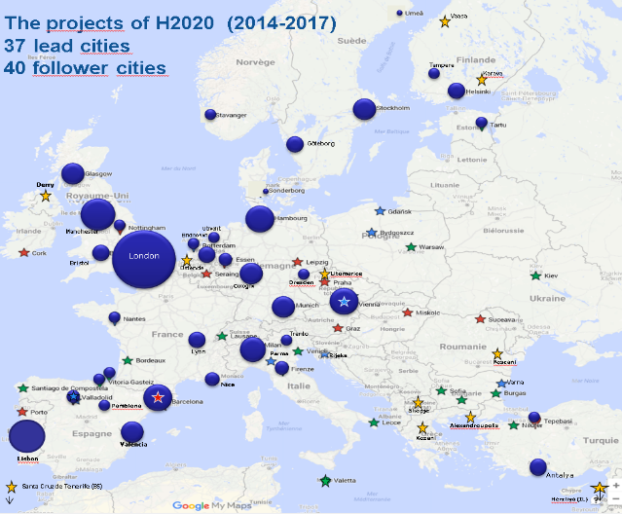
EVOLUTION OF SMART CITIES & Communities CONCEPT
CONCERTO
Smart Cities & EeB PPP
Smart Cities in H2020
CONCERTO CITIES
58 communities
23 countries
 | CONCERTO (2005-2009) | EeB PPP (2010-2013) | Smart Cities and Communities (2014 - )
Support | 175,5 M€ | 216 M€ | 264 M€
Projects/sites | 19/58 | 21/63 | 12/37
M€/year | 35,1 M€/y | 54 M€/y | 66 M€/y

Slide 22
Lighthouse projects - General concept:
Lighthouse cities leading the way demonstrating innovative smart city solutions
Follower cities learning together with the Lighthouse cities. No first movers risk.
Close collaboration among cities

Slide 23
Lighthouse projects – aims
facilitate a successful transformation towards intelligent, user-driven and demand-oriented city infrastructures and services.
form a continuously growing network of collaboration

Slide 24
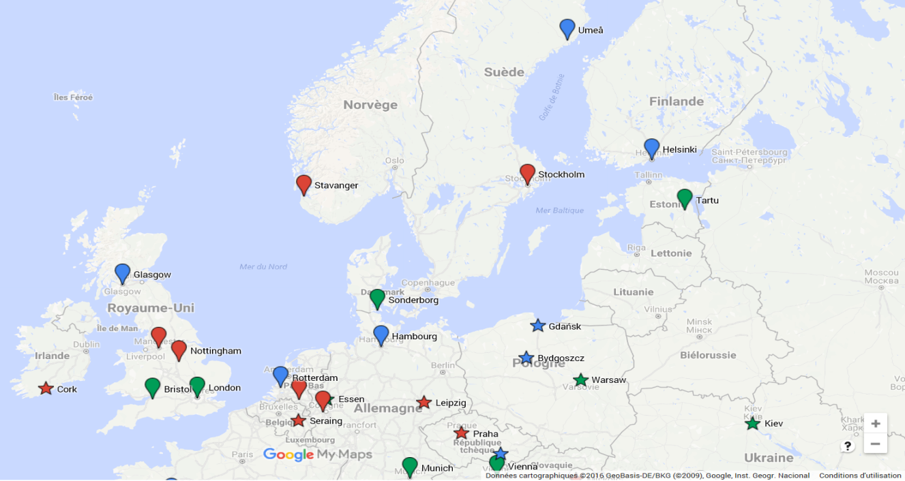
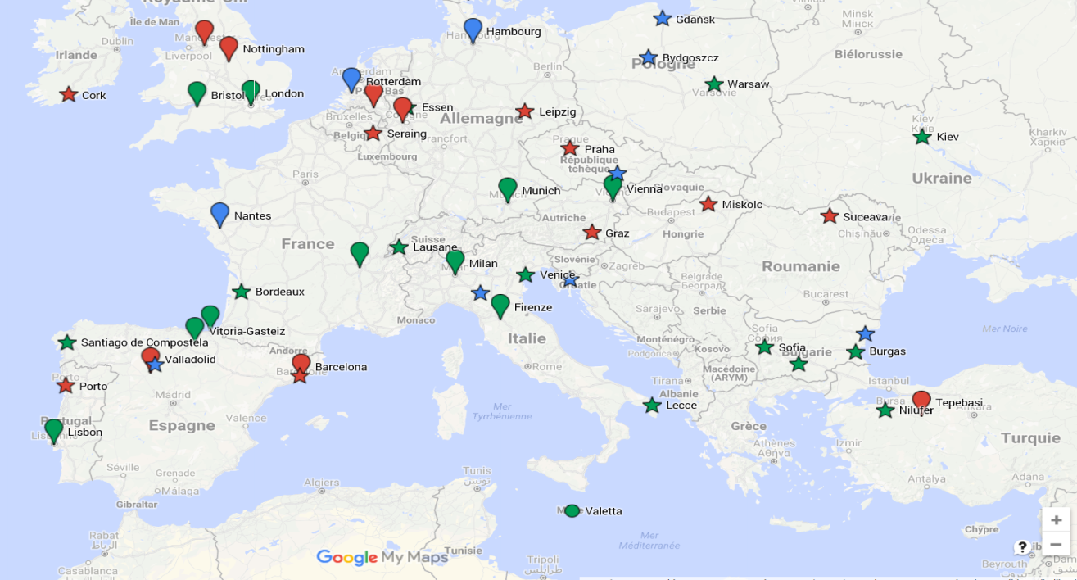
The projects of H2020 (2014-2017)
37 lead cities
40 follower cities
Vaasa
Tampere
Lead
cities
2014-17
Karava
Göteborg
Derry
(Size by population)
Manchester
Utrecht
London
Eindhoven
Follower
cities
Bristol
Ostende
Dresden
Litomerice
Cologne
2017
Trento
2016
Lyon
Parma
Rijeka
Foscani
2015
Nice
Varna
2014
Pamblona
Skopje
Alexandroupolis
Valencia
Kozani
Lisbon
Antalya
Santa Cruz de Tenerife (ES)
Herzliya (IL)

Slide 25
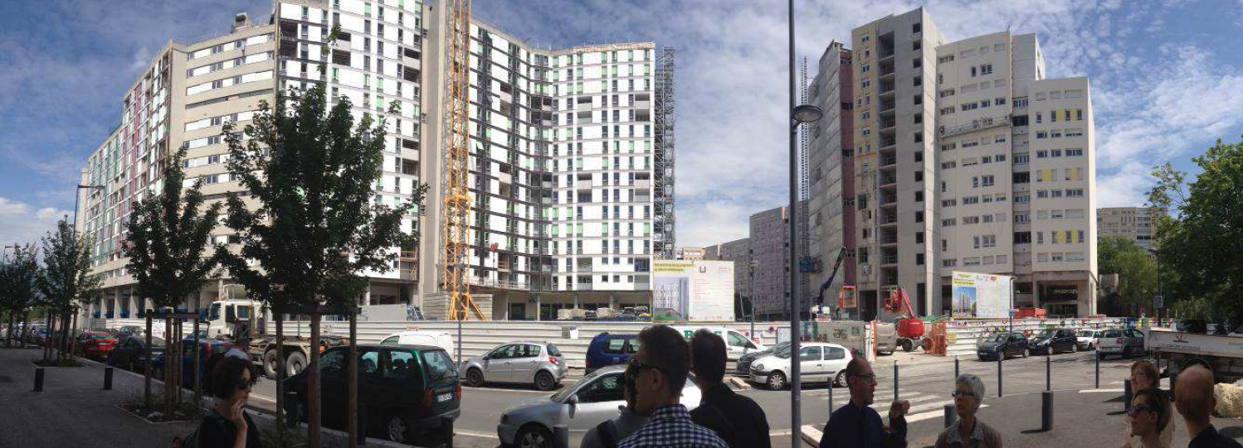
ZenN project
(FP7 completed project)
Grenoble
Source:Zenn project progress report
243 nearly zero energy retrofitted apartments
90,000 m² renovated residential buildings
10,000 connected dwellings with a Smart Grid

Slide 26
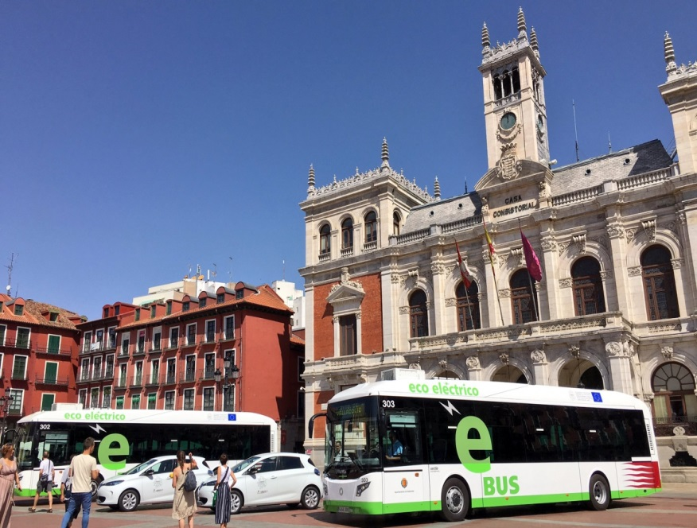
REMOURBAN H2020 project
Valladolid
Actions:
ICT platform for energy performance monitoring
24.700 m2 district retrofitting
398 dwellings | 1.000 residents
RES heating & cooling - Biomass district heating
Combined Heat and Power generation (CHP) | Photovoltaic panels on façade
Advanced Systems for monitoring of district heating
and building comfort controllers
Fleet of electric vehicles
smart metering infrastructure
Road systems - smart phone apps
Peer-to-peer transport information
Expected impacts:
50% Energy savings
80% CO2 emissions avoided
5.700 citizens directly involved

Slide 27
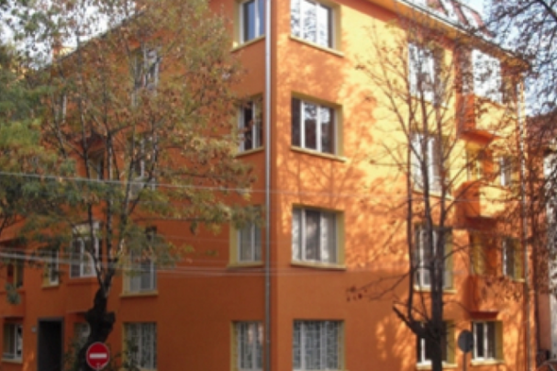
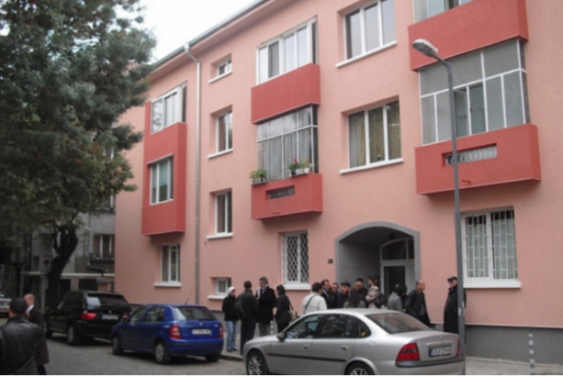
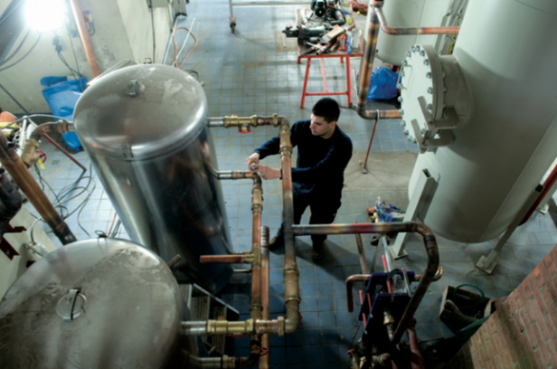
(FP7 completed project)
Sofia
Actions:
An area of 40.000m2 Apartment blocks
from 1970’s retrofitted
solar energy systems of 600 m2 installed
together with District heating
Worked through home owners associations to
build lending capacity and attract discounts
Impacts
70% energy savings for space heating
Sun shading devices will reduced the
overheating problem
.

Slide 28
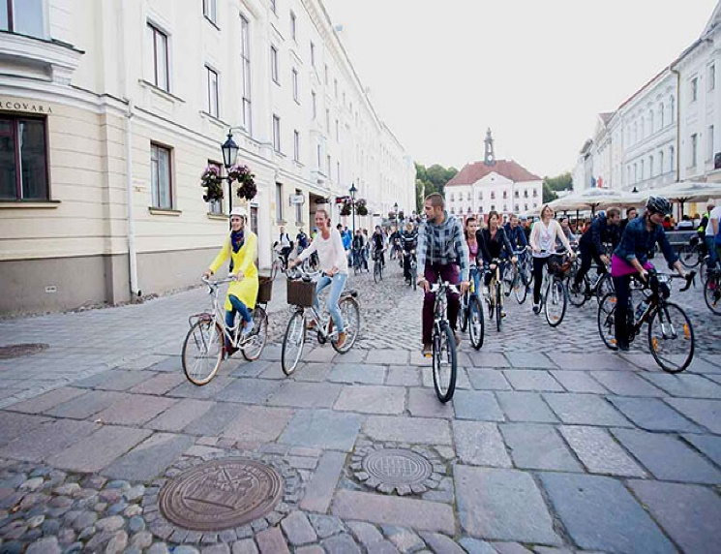
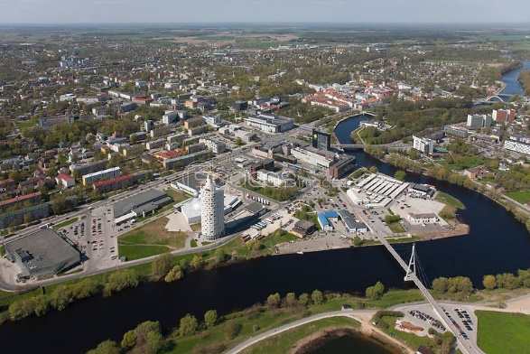
SmartEnCity H2020 project
Tartu-Estonia
Actions:
efficient renovation of 900 Khrushchev-era apartments
waste heat into the district heating network
recycling old batteries used in electric vehicles,
installation of new charging points,
e-car sharing
LEDs and sensor-based street lighting)
renewable energy (production and storage)
installation of sensors (noise, air pollution,
temperature, humidity, road conditions)
Development of IT tool to enable residents to monitor, analyze and adjust home energy consumption.

Slide 29
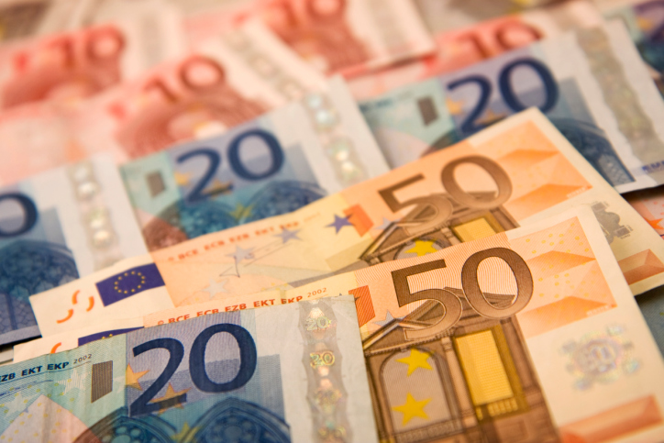
Other sources of financing
Notes:
Title will automatically show after 1 second, don't click!

Slide 30
European Fund for Strategic Investments (EFSI) (Juncker Plan)
An initiative of EIB Group and the European
Commission aimed at boosting the economy through mobilising private financing for strategic investments

Slide 31
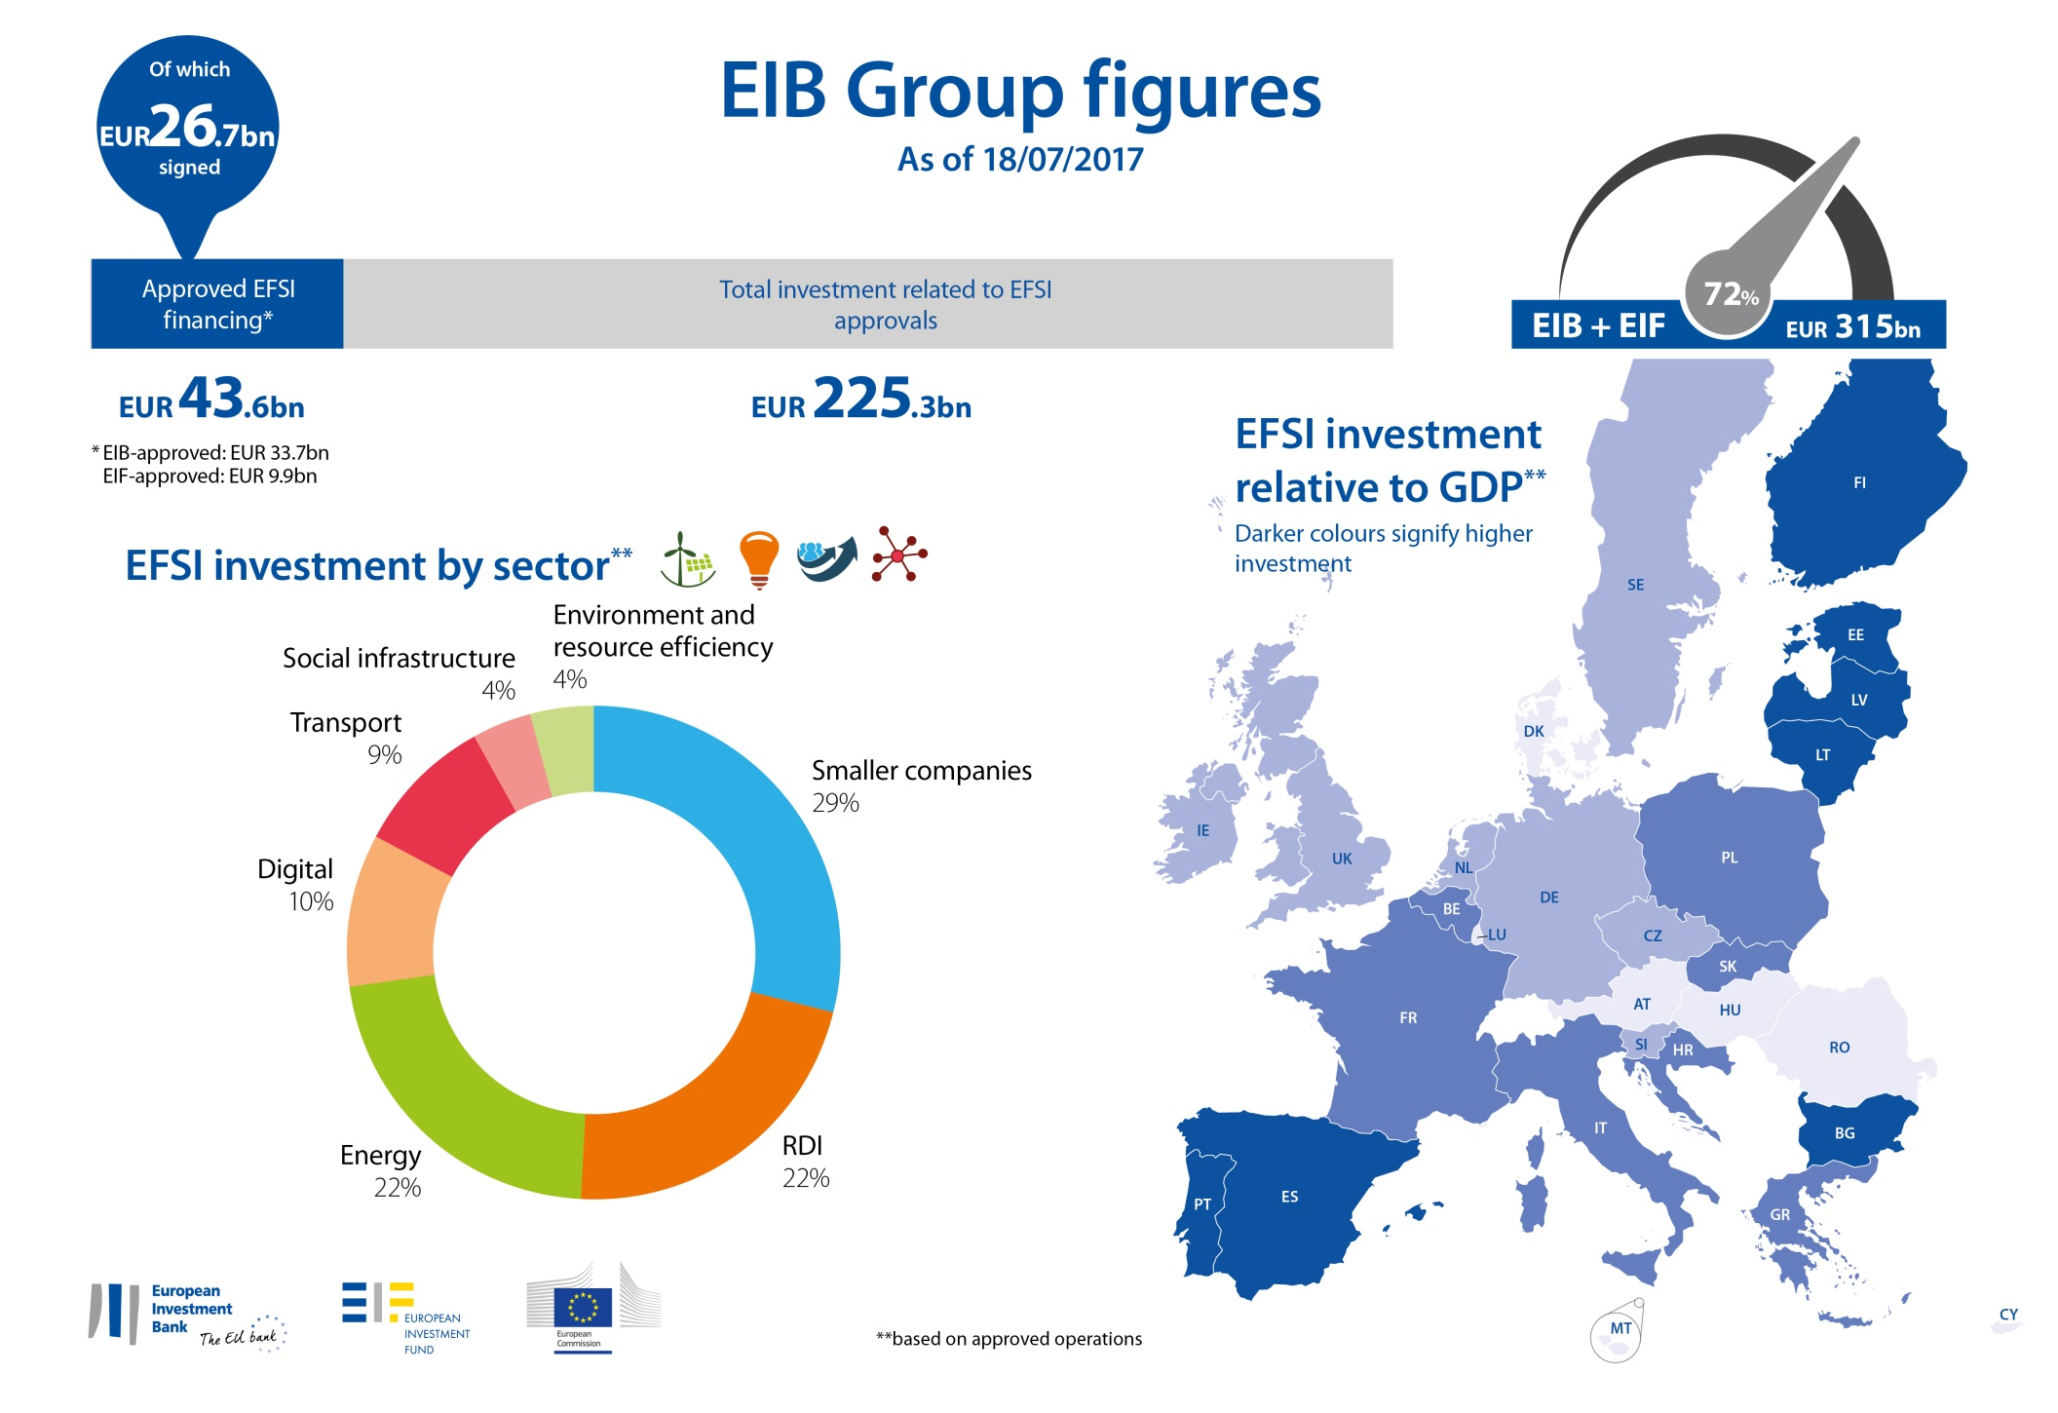

Slide 32
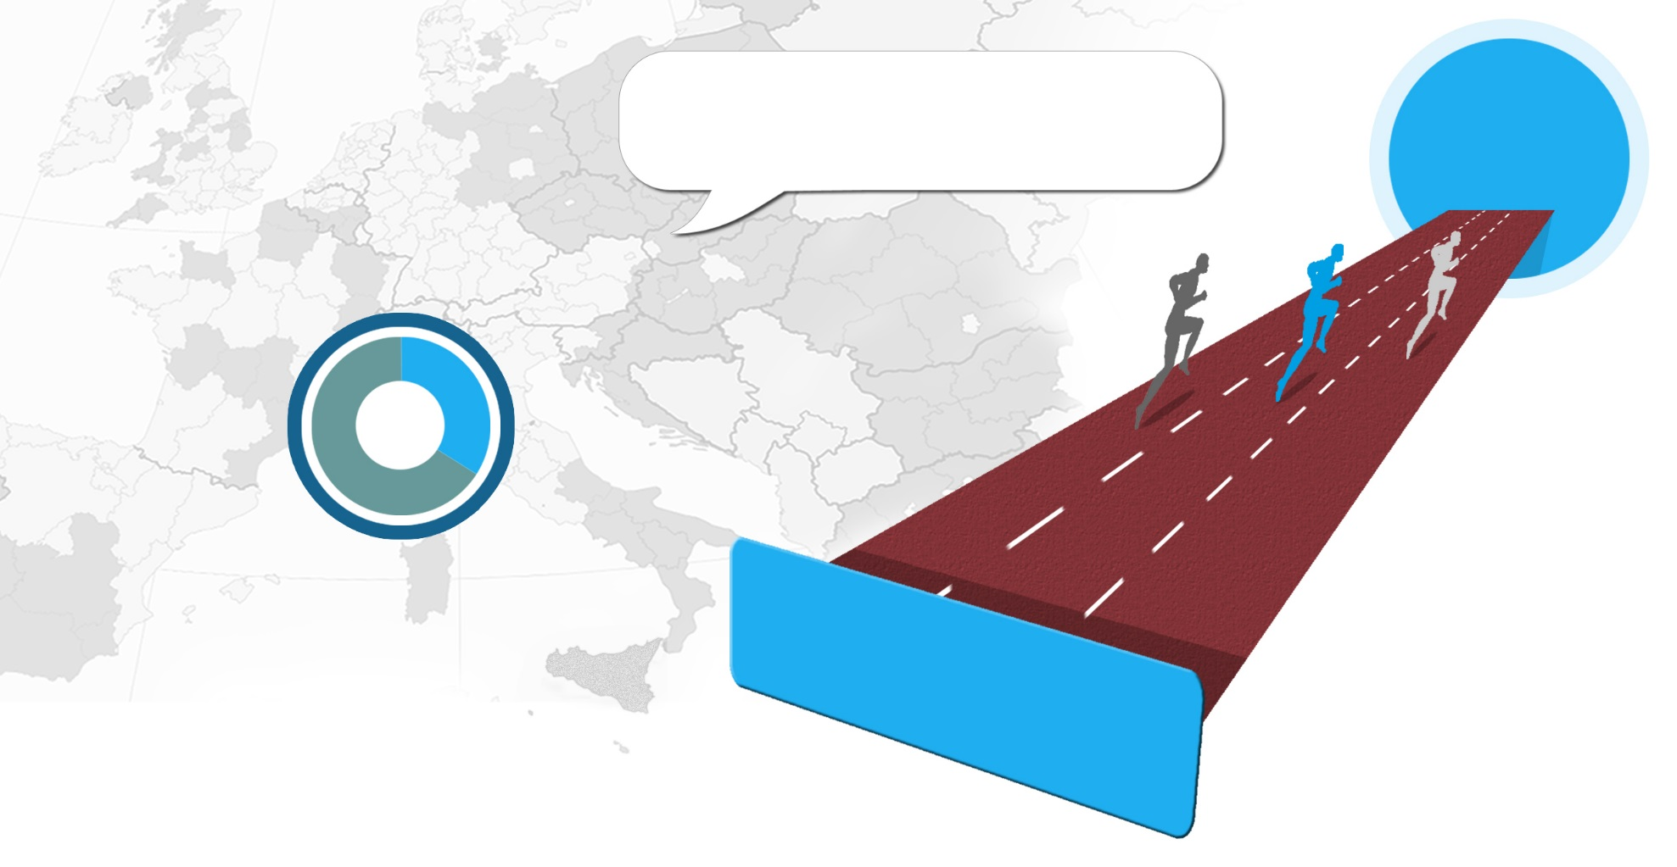
EU Cohesion Policy 2014-2020: 1/3 of the EU budget
The reforms agreed for the 2014-2020 period are designed to maximise the impact of the available EU funding.
GROWTH
OVERALL EU 2014-2020 BUDGET
€1 082 billion
67.5%
32.5%
Other EU policies
Agruculture
Research
External
Etc.
COHESION POLICY
€351.8 billion
Sustainable
Smart
Inclusive
€730.2 billion
Cohesion Policy
delivers
Europe 2020 Strategy
Notes:
After the mid-term review of the cohesion policy allocations (June 2016), the initial amount of EURbn 351.8 becomes EURbn 356.5.

Slide 33
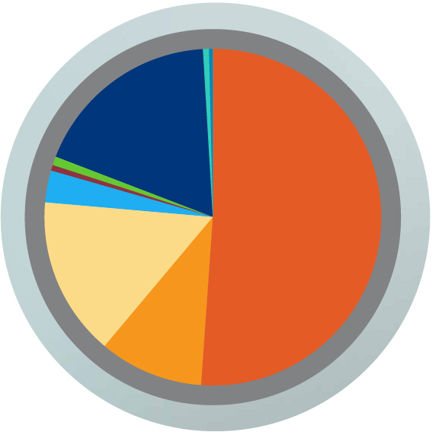
Cohesion Policy Funding 2014-2020 (€ 356.5 bn)
€ 181.3 bn
€ 38.0 bn
€ 57.4 bn
€ 10.1 bn
€ 0.4 bn
€ 3.2 bn
€ 63.3 bn
€ 1.6 bn
€ 1.2 bn
Less developed regions
Transition regions
More developed regions
European territorial cooperation
Urban innovation actions
Youth employement initiative (top-up)
Cohesion fund
Specific allocation for outermost and
sparsely populated regions
Technical assistance
Notes:
Amounts adjusted by the mid-term review of the allocations (2016) and by transfers between years.
33

Slide 34
Budget allocations per Member State (2014-2020)
Notes:
BE 2.3
BG 7.6
CZ 21.9
DK 0.6
DE 19.2
EE 3.6
IE 1.2
EL 16.5
ES 30.7
FR 15.9
HR 8.6
IT 34.5
CY 0.8
LV 4.5
LT 6.8
LU 0.1
HU 21.9
MT 0.7
NL 1.4
AT 1.2
PL 77.6
PT 21.5
RO 23
SI 3.1
SK 13.9
FI 1.5
SE 2.1
UK 11.9

Slide 35
What measures and ERDF and CF expected results?
  Energy efficiency for lower energy bills, better living and working conditions, local jobs and competitive businesses
  € 7.9 billion for energy efficiency in public infrastructure, notably buildings, contributing to public buildings using 5.2 TWh/year less energy than now
  € 5.4 billion for energy efficiency in residential buildings, contributing to 875 000 households with energy renovated dwellings
  € 3.4 billion to support energy efficiency in 57 000 enterprises, mainly small and medium-sized
  € 1.7 billion to support high-efficiency cogeneration of heat and power and district heating
  Planned ERDF and CF allocations as of May 2016

Slide 36
What measures and ERDF and CF expected results?
  Renewable energy, smart energy infrastructure and research and innovation for a transformed energy system
  € 4.9 billion for renewable energy, contributing to around 7 670 MW of additional capacity of renewable energy production
  € 1.1 billion for smart distribution grids, contributing to 3.3 million additional energy users connected to smart grids
  € 2.3 billion for infrastructure for smart electricity and gas storage and transmission systems, mainly in less developed regions in six MS
  At least € 2.6 billion for low-carbon research and innovation, but possibly more based on smart specialisation strategies
  Planned ERDF and CF allocations as of May 2016

Slide 37

Connecting Europe Facility (CEF)
Key investments for European infrastructures (2014-2020)
Total
€ 30,4
billion
Transport
Energy
Telecom
€ 24,05
billion
€ 5,35
billion
€ 1,04
billion
Notes:
Connecting Europe Facility
The Connecting Europe Facility (CEF) is a key EU funding instrument to promote growth, jobs and competitiveness through targeted infrastructure investment at European level.

Slide 38

Upcoming
Events

Slide 39

15th CIVITAS FORUM Conference 2017
1/6)
Torres Vedras, Portugal
27-29 September 2017
http://civitas.eu/content/save-date-civitas-forum-conference-2017

Slide 40

2/6)
Smart Cities Information system conference
Budapest, Hungary
2&3 October 2017
http://www.smartcities-infosystem.eu/newsroom/news/save-date-scis-conference-empowering-smart-solutions-better-cities

Slide 41

3/6)
European Week of Regions and Cities
http://ec.europa.eu/regional_policy/regions-and-cities/2017/index.cfm

Slide 42

4/6)
EIP General Assembly 2017
Brussels, Belgium
12th October, 2017
https://eu-smartcities.eu/content/general-assembly-12-october-2017-1

Slide 43
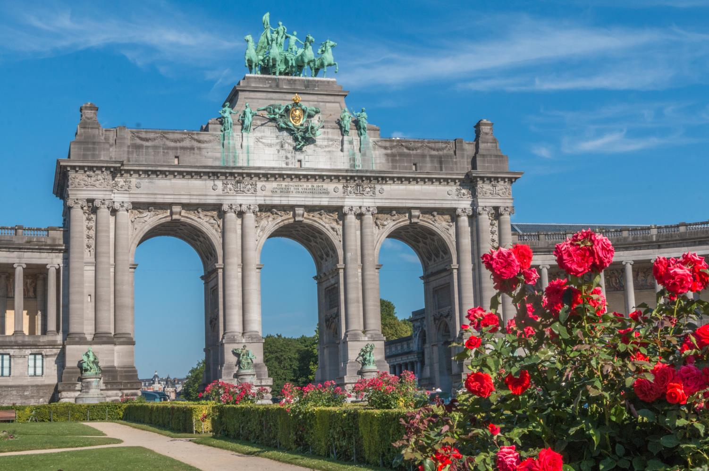
General Assembly 2017
Programme Outline
Breakfast tables with investors, cities, industries to prepare potential pilot project deals
Involvement of three Commissioners
Panel on scaling up and replication of H2020 Lighthouse projects and existing initiatives
Panel on concrete financial support from banks, structural funds and other sources
International dimension: market opportunities for Europe and lessons learnt
43

Slide 44
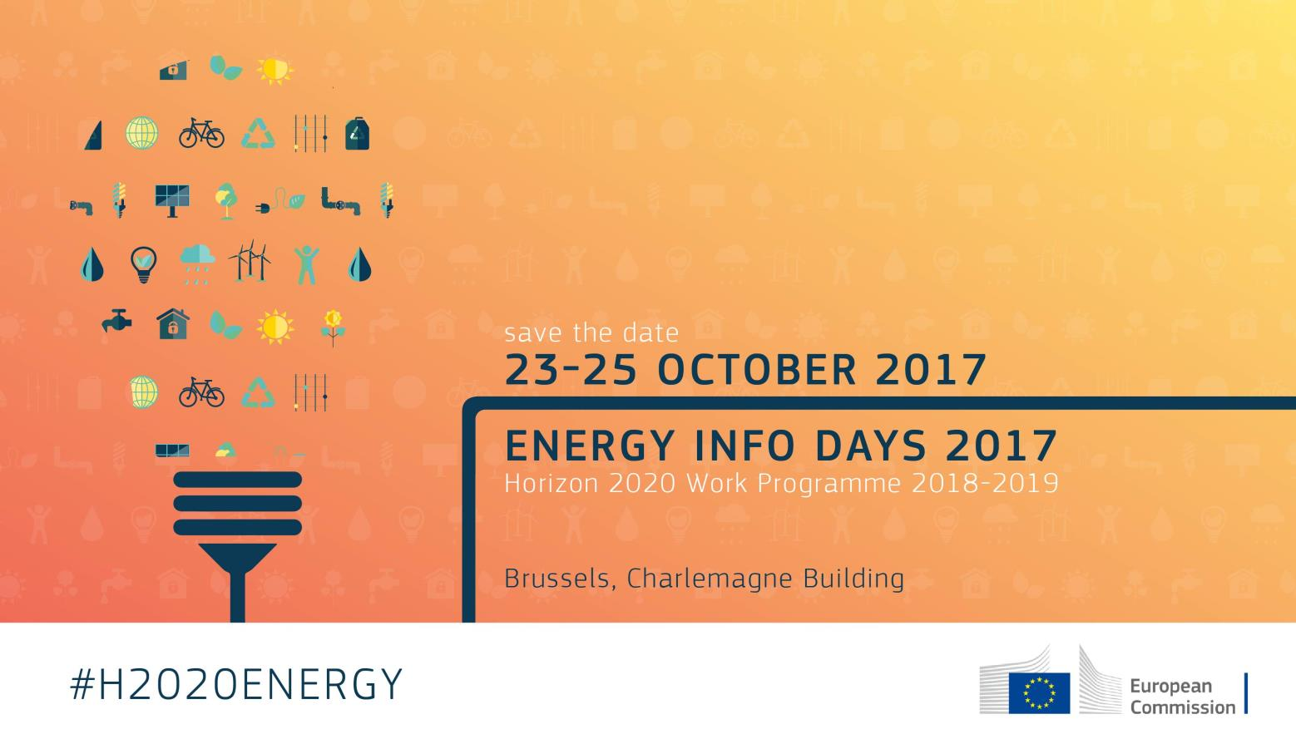
5/6)
Energy INFO DAYS 2017
Smart Cities
on
24/10
Brussels, Belgium
23-25/10/2017
https://ec.europa.eu/inea/en/news-events/events/energy-info-days-2017
44

Slide 45

Next relevant events (6/6)
5/6)
10th SET-Plan Conference 2017
Bratislava, Slovakia
30/11/2017 to 01/12/2017

Slide 46



Thank you!
Magdalena-Andreea.STRACHINESCU-OLTEANU@ec.europa.eu
@stracma
Get involved at http://eu-smartcities.eu! @EUSmartCities
46

